Slide 1
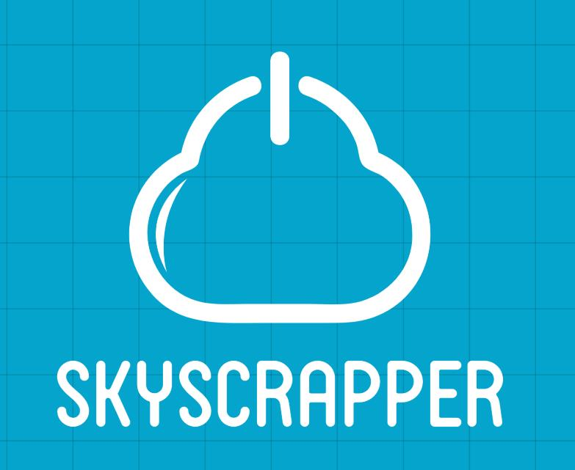
TCS Digital Ninja Programme

Slide 2
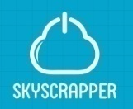


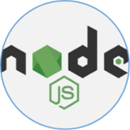

Our Team’s Learning
Highlights
MEAN
Cloud Computing
MEAN Stack
CI/CD pipelines
Conclusion
Fresco Play Courses
Customer Transaction Management

Slide 3
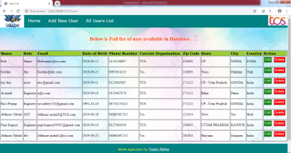


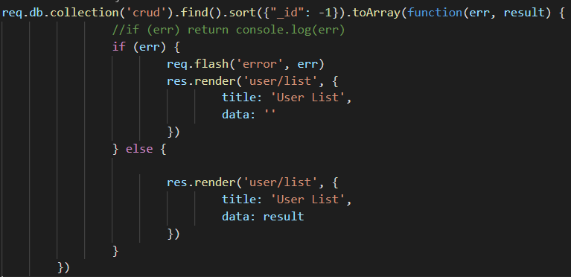
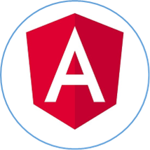


Render UI with dynamic data
Handle User input
Communicate with backend services
No SQL Database which stores “Documents” in “Collections” (instead of records in tables as in SQL)
8.
Request for Http://localhost:4200/
Return Request to Angular
4.
Make Request to database
7.
Retrieve the data and return response to ExpressJs
5.
1.
Listen to request and parse it
Execute Business Logic
It is middleware based Node Framework that funnel requests through functions and implies writing Server Side code and logic
Return Database to node
Client Side(Browser) Framework which allows you build Single Page application
6.
2.
3.
Create (POST) – Make something
Read (GET)_- Get something
Update (PUT) – Change something
Delete (DELETE)- Remove something
Server Side Library: JavaScript on the server side

Slide 4
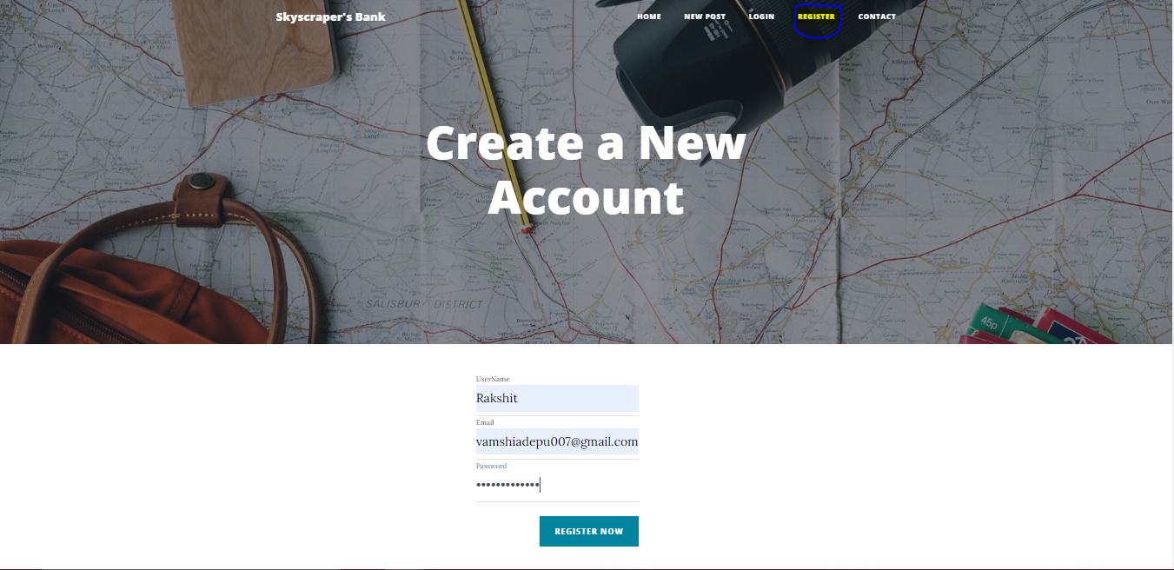
New User Registration
The user launches the website with provided URL Http://localhost:4200/, then he lands on Home Page.
In the navigation bar when we hover to Register button, it will navigate to User Registration Page.

Slide 5
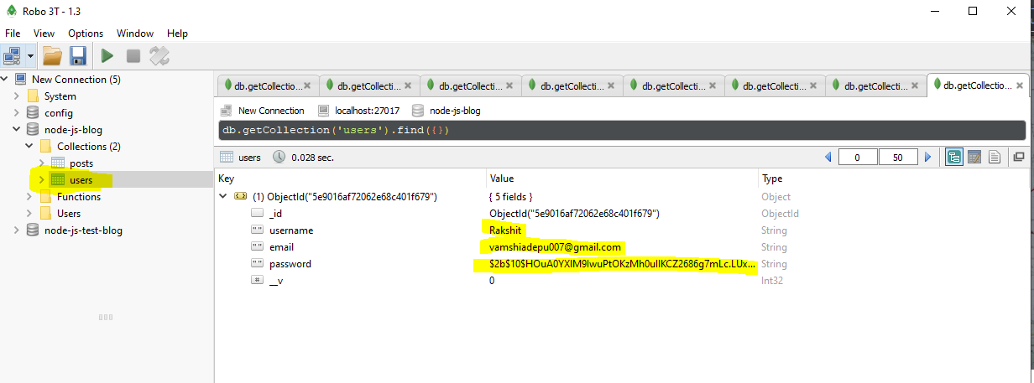
Data recorded in MongoDB
After entering the Valid details of Username, Email and password.
The data is posted into MongoDB by Browser via NodeJS.

Slide 6
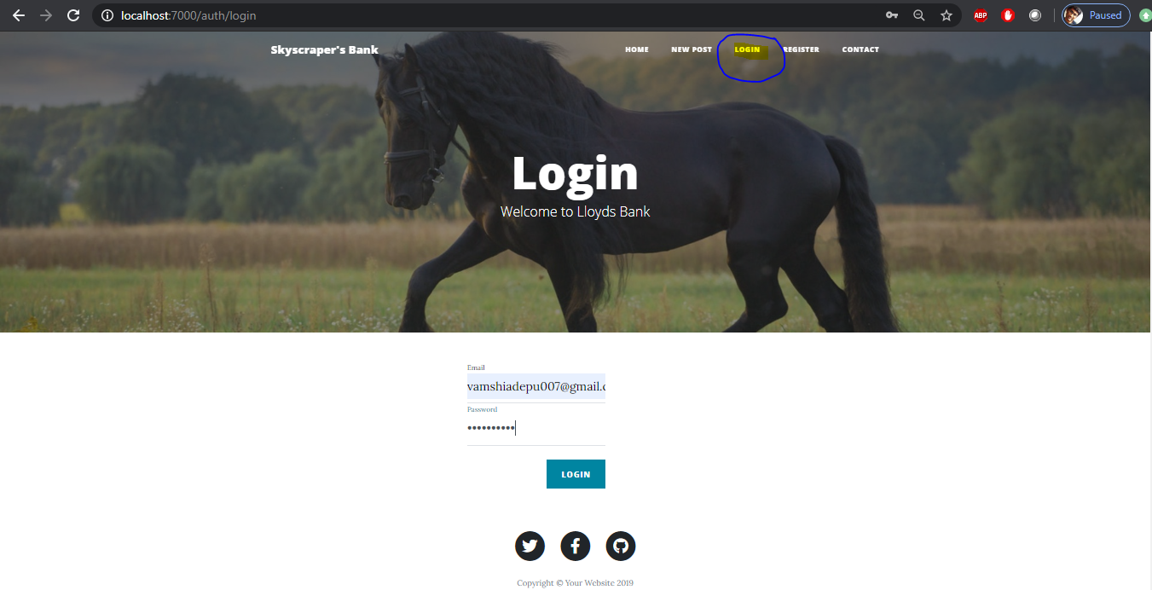
User Login
After successful Registration, the User will navigate to Home Page to Login.
Then upon clicking Login button on the navigation bar, the website will direct to Login page.

Slide 7
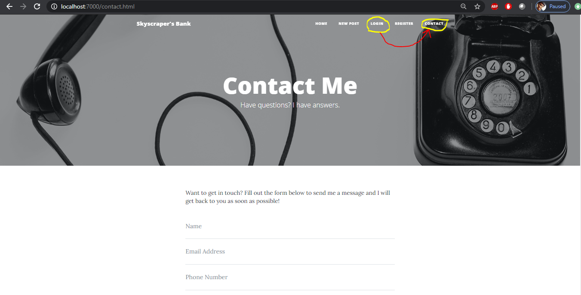
Contact Page
After successful Login, User directed to Contact page and,
In case of unsuccessful login, the user will get error pop-up to login with correct details.

Slide 8
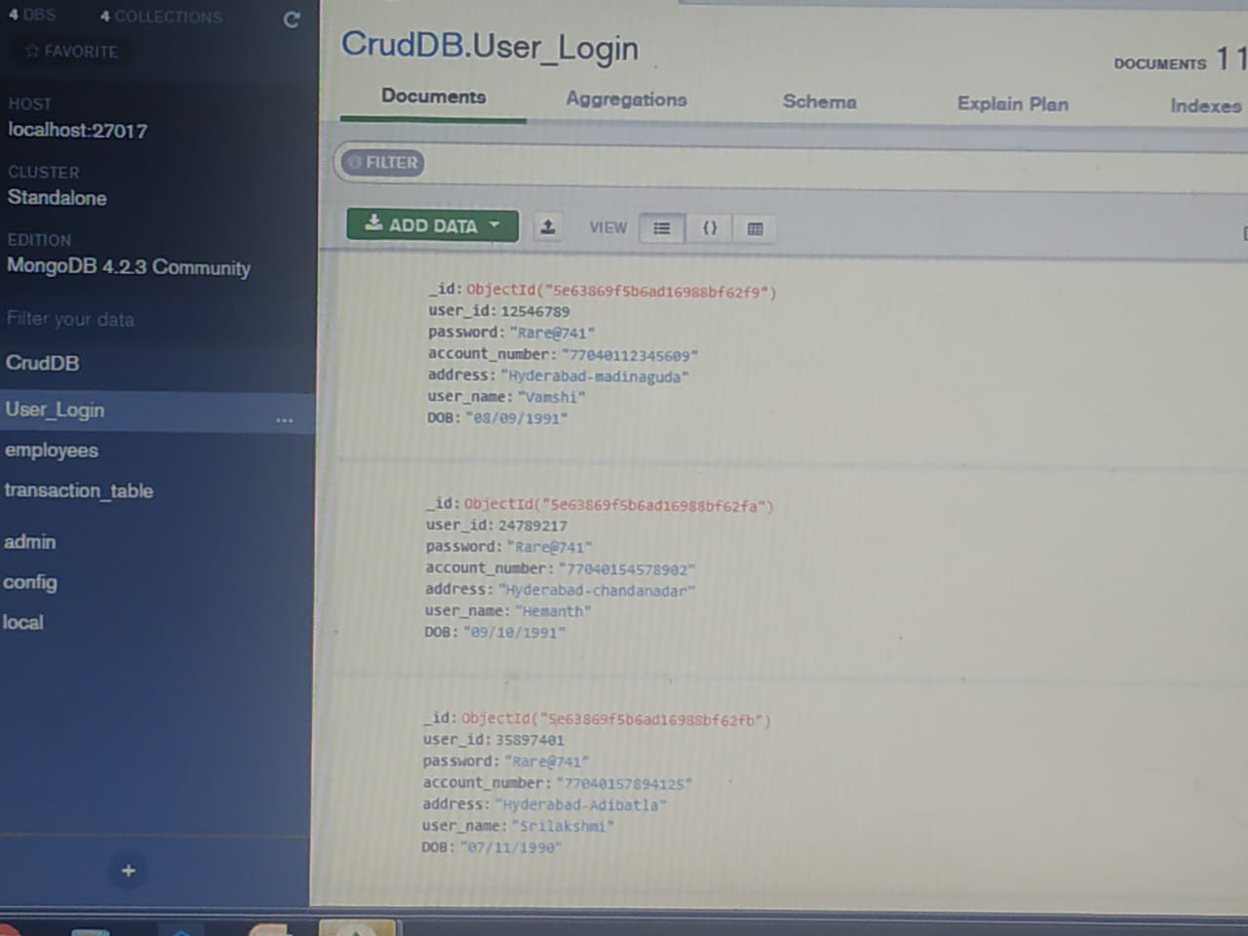
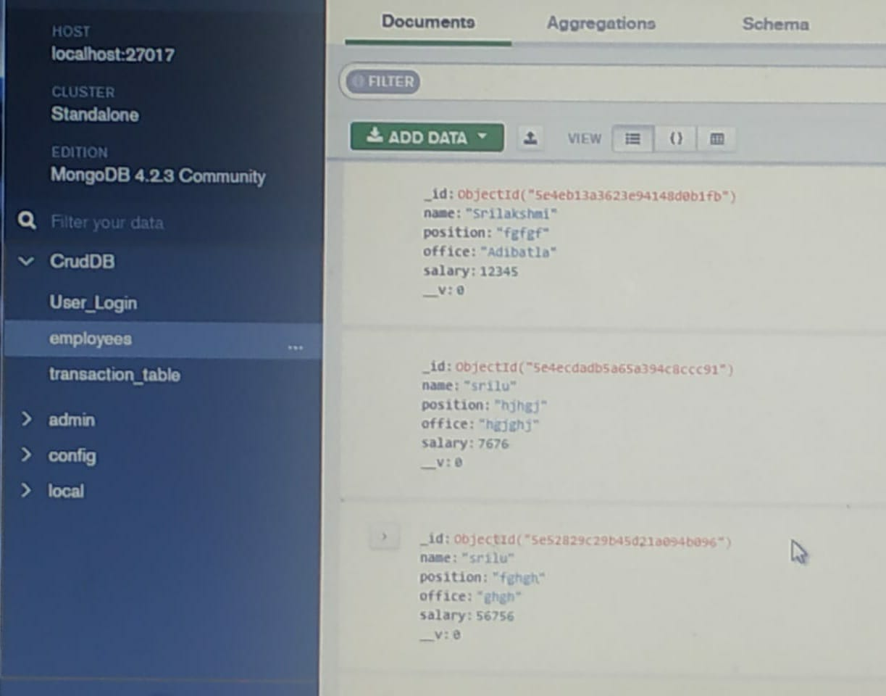
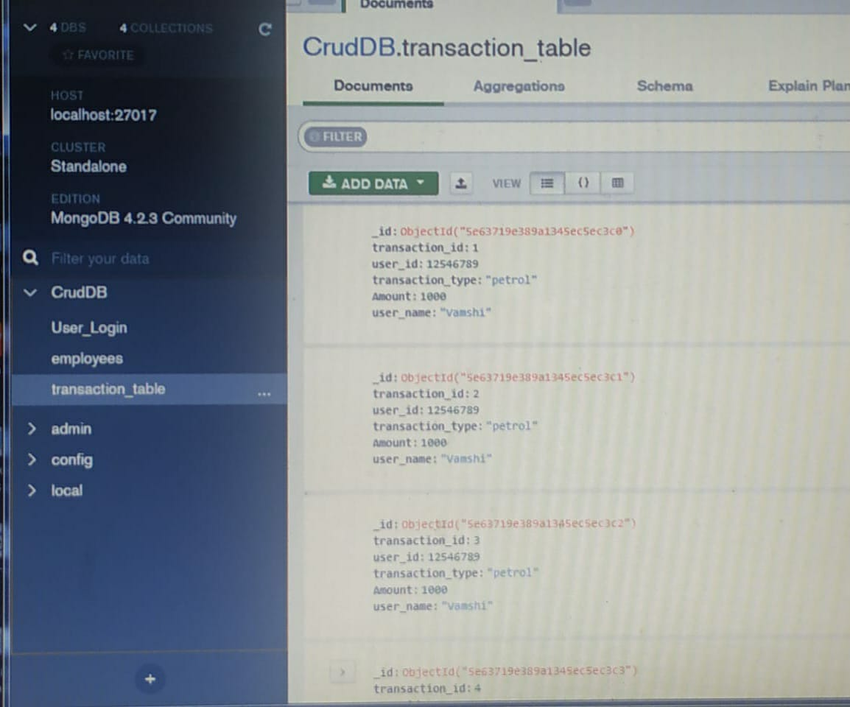
User Table
Use Case Database and Tables
Employee Table
Transaction Table

Slide 9
Team’s Learning
Names | Cloud Platform | Version Control | MEAN Stack | CI/CD pipeline
Hemanth Kumar Reddy | 1.Cloud computing internal Certification 2.AWS essentials 3.Data Handling using R 4.Azure Essentials 5.Data Visualization using R 6.APIGEE-Developer Services | 1.More on Git 2.Develpoer's Git 3.Git slack Integration 4.Revision Control on git platform Assessment | 1.Angular 2 routes and Forms 2.UI design | 1.Continuous Deployment 2.Devops Culture
Ganesh Dasari | 1.Google cloud Platform-Fundamental certification 2.AWS essentials 3.Google Cloud Essentials 4.Azure Essentials 5.Azure Virtual Machines 6.Amazon ECS and Storage Gateway 7.Cloud Computing | 1.More on Git 2.Develpoer's Git 3.Git slack Integration | 1.AngularJS Routers and Custom Directives 2.Angular - Routes and forms 3.AngularJs Packaging and Testing | 1.Contunious Integration with Jenkins 2. Continuous Deployment
Debashish Choudhury | 1.Google Cloud Essentials 2.AWS essentials 3.External certifications:- Google cloud certification-coursera | 1.Develpoer's Git 2.Git slack Integration | 1.Angular 2.No SQL -database revolution 3.Styli CSS-3 4.HTML 5 | 1.Contunious Integration with Jenkins 2. Continuous Deployment 3.Devops Culture 4.Continuous Integration
Priyanka Katakam | 1.Google Cloud Essentials 2.Google BigQuery 3.AWS Essentials 4.Azure Essentials Continum 5.Azure Virtual Machines 6.External certifications:- Google cloud certification-coursera | 1.More on Git 2.Develpoer's Git 3.Git slack Integration | 1.AngularJS Packaging and Testing 2.AngularJS 1.x Routers and Custom Directives 3.MongoDB Cartula Inceptivus | 1.Contunious Integration with Jenkins 2. Continuous Deployment 3.Devops Culture 4.Continuous Integration 5.Styling with CSS3

Slide 10
Team’s Learning
Names | Cloud Platform | Version Control | MEAN Stack | CI/CD pipeline
Shweta Mathur | 1.Cloud computing 2.Google Cloud Essentials 3.AWS Essentials 4.Azure Essentials 5.Serverless | 1.More on Git 2.Develpoer's Git 3.Git slack Integration 4.Bit Bucket | 1.MongoDB Cartula Inceptives 2.MongoDB Perpetuus 3.No SQl -database revolution 4.Node.js essentials 5. AngularJS Packaging and Testing | 1.Contunious Integration with Jenkins 2. Continuous Deployment 3.Devops Culture 4.Continuous Integration
Sai Srinivas Kandula | 1.Google Cloud Platform-Fundamentals: Core Infrastructure 2.Azure Virtual Machines 3.AWS Essentials 4.Azure Essentials 5.Essential Cloud Infrastructure Foundation 6. Foundation of IBM Cloud Reference Architecture- External | 1.More on Git 2.Develpoer's Git 3.Git slack Integration | 1.AngularJS Packaging and Testing 2.AngularJS 1.x Routers and Custom Directives 3.Angular 2 Routes and Forms | 1.Contunious Integration with Jenkins 2. Continuous Deployment 3.Continuous Integration
Srilakshmi Gumma | 1.Cloud computing internal Certification 2.AWS essentials 3.Azure Essentials 5.Azure Virtual Machines 6.APIGEE-Developer Services | 1.More on Git 2.Develpoer's Git 3.Git slack Integration 4.Revision Control on git platform Assessment | 1.AngularJS Routers and Custom Directives 2.Angular - Routes and forms 3.AngularJs Packaging and Testing 4.UI Design | 1.Contunious Integration with Jenkins 2. Continuous Deployment 3.Devops Culture 4.Continuous Integration
Vamshi Adepu | 1.Cloud Computing | 1.More on Git 2.Develpoer's Git | 1.MongoDB Perpetuus 2.Boot Strap 3.Node.js essentials 4.Styli CSS-3 5.HTML 5 6. Java Script | 1.Contunious Integration with Jenkins

Slide 11
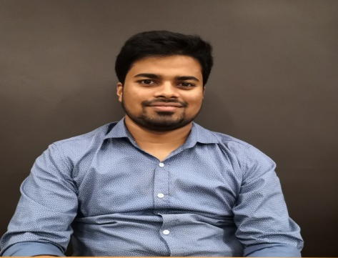
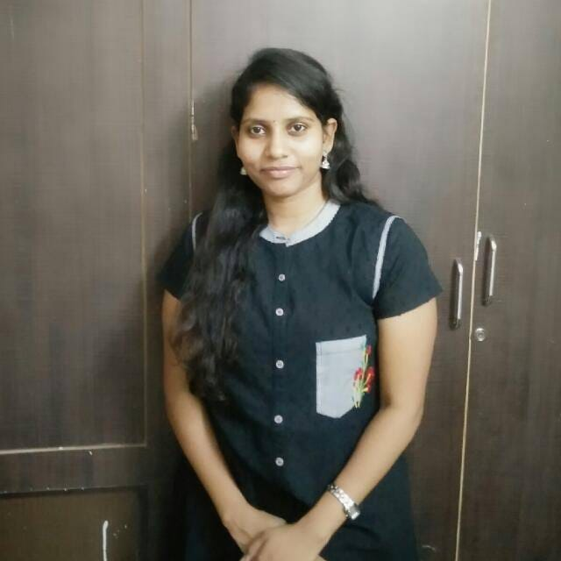

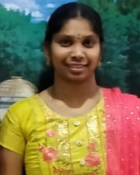


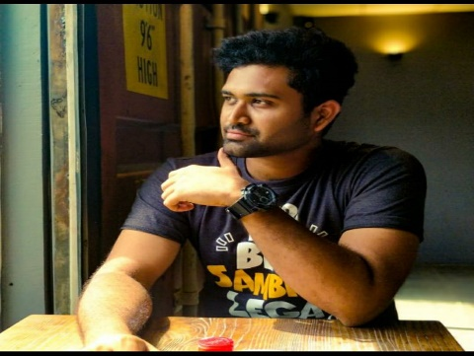
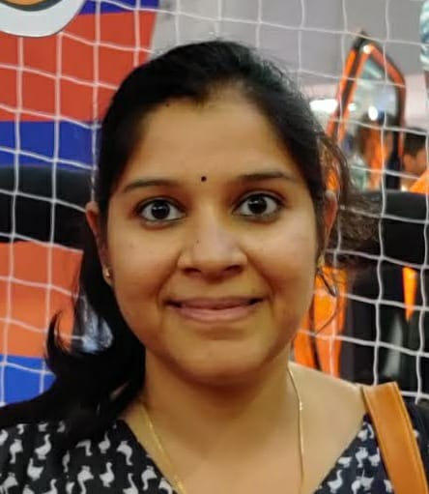
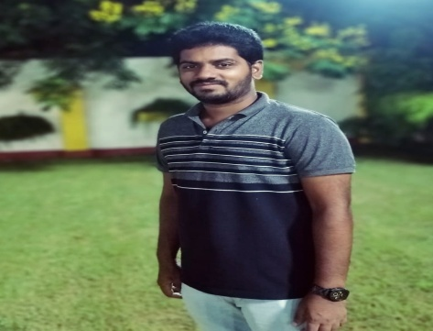
Team Sky Scrapper
Debashish Choudhury
1184432
Priyanka Katakam
843116
Hemanth Kumar
971910
Srilakshmi Gumma
555273
Tarun Parashar
455684
Sai Srinivas
987169
Vamshi Adepu
1413950
Shweta Mathur
680291
Ganesh Dasari
977819

